Slide 1
Finding similarity/difference measure between combined sketches

Slide 2
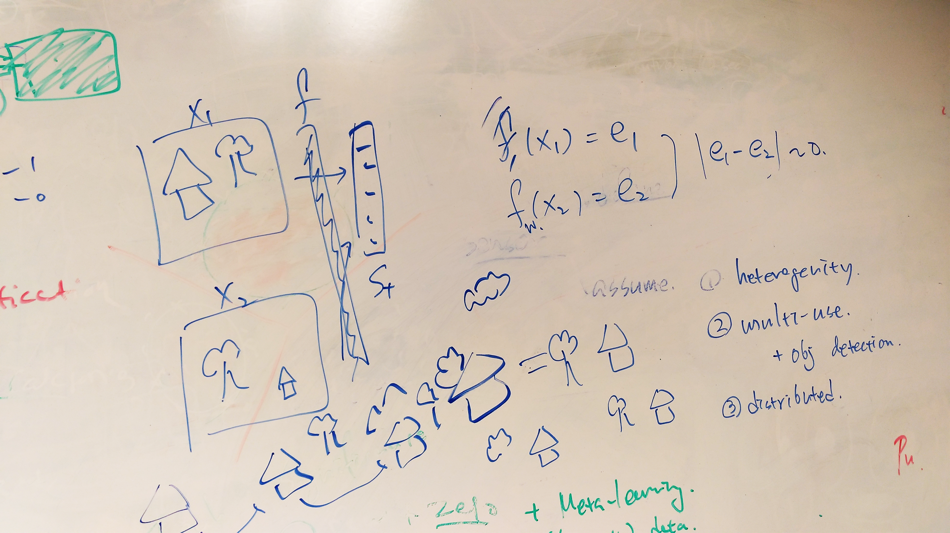
Last week discussion

Slide 3
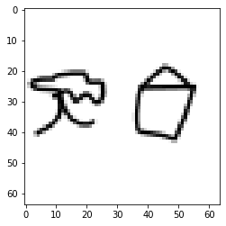
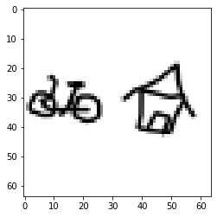
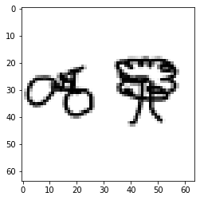
We plan to use Deep Neural Networks to measure the similarity between 2 different sketches:
Examples of sketches in the dataset that I randomly created:

Slide 4
Three classes classification
Tree house
Tree bicycle
House bicycle
240 training examples
60 testing examples
Test accuracy: 0.8833333 (with dropout layers)

Slide 5
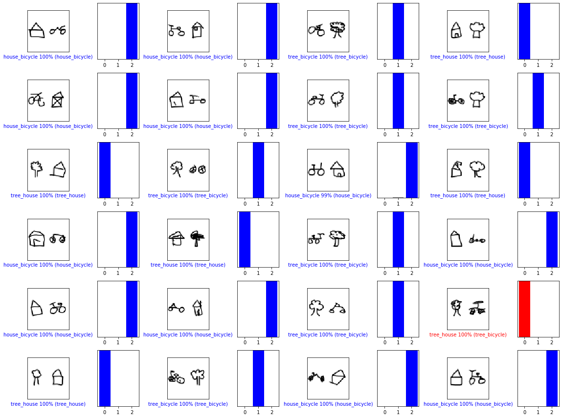

Slide 6
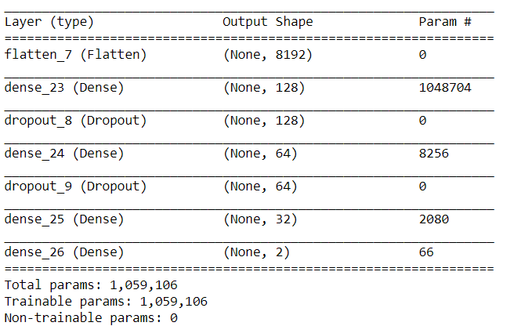
Similarity measurement
Compare 2 sketches from 3 classes above together to find out if they are similar
14400 training examples
3600 testing examples
Test accuracy: 0.99833333 (with 0.1 dropout layers)
Test accuracy: 0.83194447 (with 0.2 dropout layers)

Slide 7
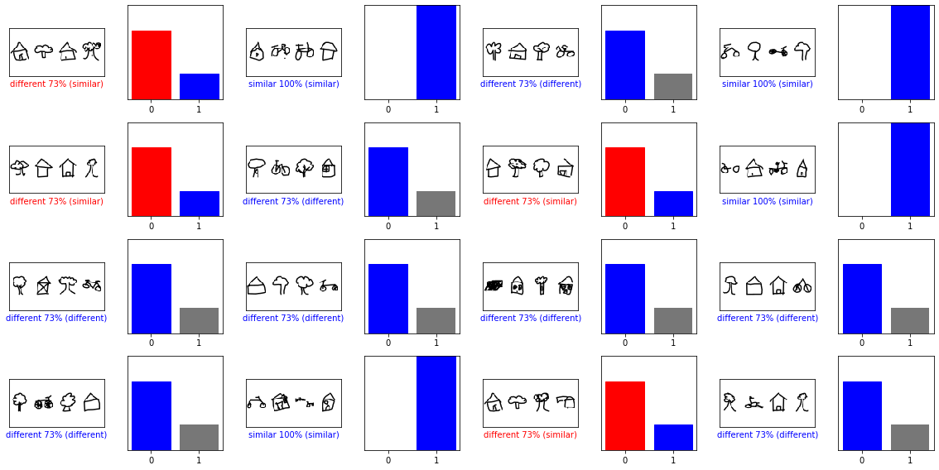

Slide 8
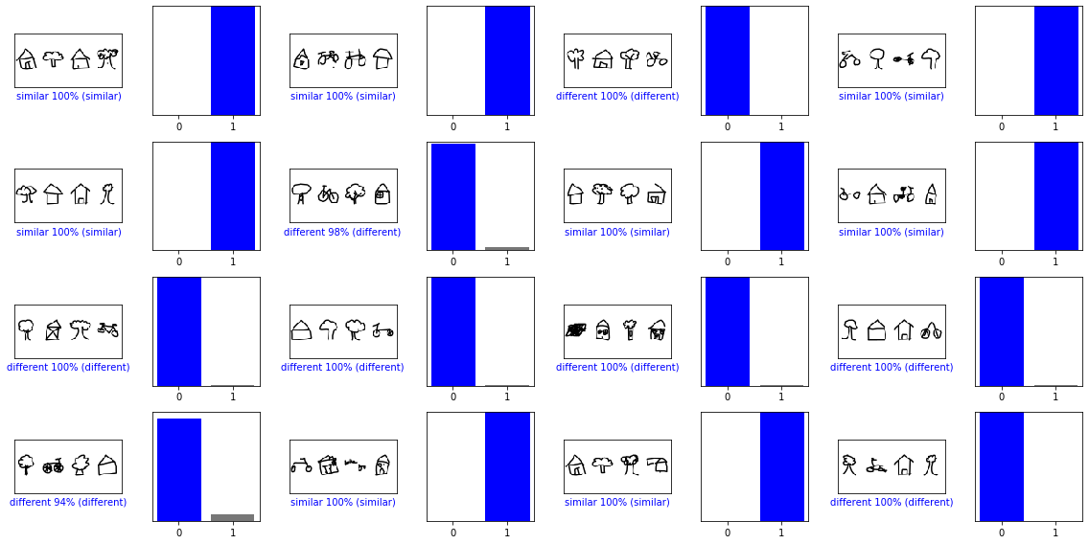

Slide 9
Next steps
Try to build a bigger dataset with more classes to see if the model still perform well

